Slide 1
Python Introduction (PVM) Python Virtual Machine
Dr. Naveen Kumar
Associate Professor
Amity Institute of Information Technology
Amity University Patna

Slide 2
Python Virtual Machine
The Python Virtual Machine (PVM) is the runtime engine of the Python programming language that executes platform-independent bytecode using a stack-based architecture.
The primary components of the PVM architecture and its execution process are:
Bytecode Compiler: When Python source code (.py file) is run, the compiler first translates it into a low-level, platform-independent intermediate representation called bytecode. These instructions are cached in .pyc files.
Memory Management: The PVM manages memory dynamically, including memory allocation and an automatic garbage collector that reclaims unused memory.
Stack-based Execution Engine (Interpreter Loop): The core of the PVM is the interpreter loop, which fetches, decodes, and executes the bytecode instructions sequentially. It is a stack-based machine, meaning it uses a value stack to store and retrieve intermediate values, operands, and results during computations.
Frame Objects: The PVM uses frame objects to manage the runtime environment of a function call, including references to local and global variables, the code object of the function, and the current instruction pointer.
Python Object Model and Standard Library: The PVM maintains the Python object model for all data types (integers, strings, lists, etc.) and interacts with Python's extensive standard library during execution.
This architecture provides Python with its key advantage of cross-platform compatibility: the same bytecode can run on any system that has a compatible PVM installed. The most common implementation of the PVM is part of CPython, the reference implementation of Python.

Slide 3
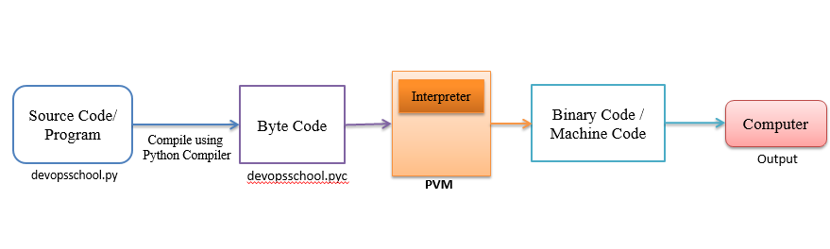
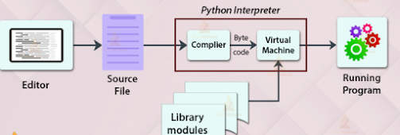

Slide 4
The Python Virtual Machine (VM) is a crucial component of the Python runtime environment. It executes Python bytecode, which is generated from Python source code or intermediate representations like Abstract Syntax Trees (ASTs).
The Python Virtual Machine, often referred to as the Python interpreter, is responsible for executing Python code. It serves as an abstraction layer between the Python bytecode and the underlying hardware, providing a consistent environment for running Python programs across different platforms. The Python VM is implemented in CPython, the reference implementation of Python.

Slide 5
Architecture of the Python Virtual Machine
Bytecode Generation: Before execution, Python source code is compiled into bytecode. This bytecode is a platform-independent intermediate representation of the Python code.
Interpreter Loop: The heart of the Python VM is the interpreter loop. It fetches bytecode instructions, decodes them, and executes them sequentially.
Python Object Model: The Python VM maintains a Python object model to represent data types, such as integers, strings, lists, and custom objects. It manages the creation, manipulation, and destruction of these objects during execution.
Memory Management: The Python VM handles memory allocation and garbage collection to manage the memory used by Python objects dynamically.

Slide 6
Bytecode Execution Process
Loading Bytecode: The Python VM loads bytecode from the compiled .pyc files or directly from memory if the code is generated dynamically.
Interpreter Loop Execution: The interpreter loop fetches bytecode instructions, interprets them, and executes corresponding operations. It maintains a stack to store intermediate values and operands.
Execution of Instructions: Bytecode instructions represent operations like loading values, arithmetic computations, function calls, and control flow (e.g., jumps, loops). The interpreter executes these instructions efficiently.
Runtime Environment Management: The Python VM manages the runtime environment, including namespaces, function calls, exceptions, and module imports.

Slide 7
The architecture comprises of four important parts:
1] Compiler
2] Interpreter
3] Memory manager
4] Stack

Slide 8
From the above figure, let us consider we have a file named “basics.py”.
This is the source file, now the compiler will take this file and do its lexical analysis, syntax analysis, semantics analysis, and then bytecode generation is done.
Provided there are no errors in any of the processes. In Bytecode, it can be compared to instructions in assembly language.
Later, in this Bytecode, if we check in any editor, it would be like certain garbage values as the editor won’t understand the bytecode.
After these states, the interpreter will now come into the picture.

Slide 9
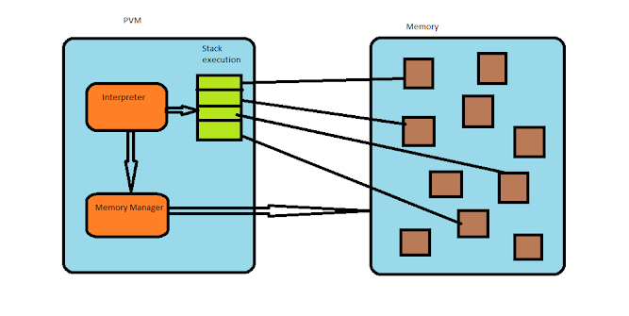

Slide 10
After the generation of the bytecode from the source code now PVM functioning will start.
We have an interpreter, which will take the Bytecode and call the memory manager via some functions or APIs and ask to create a memory object in the memory section.
Using some other API’s Memory manager will create these objects. Also, the interpreter will create a stack for the execution and the memories for the instruction set will be referenced which was the prior task of the memory manager.
So, now in the stack execution, we have something called the Call stack.
It is in the frame format with the Value stack and Block stack being part of each frame.
As we saw earlier we have a memory manager which is responsible for making the links for a memory object.
For the stack in each frame, it will have allocated memory references pointing to these memory objects.

Slide 11
